Slide 1

How
I
Learned
to
Stop
Worrying
and
Love
the
Zygohistomorphic Prepromorphism
Ivan Towlson
Microsoft
http://www.heyuguys.com/top-10-best-worst-days-in-cinema/peter-sellers-as-dr-strangelove/

Slide 2
How
I
Learned
to
Stop
Worrying
and
Love
SharePoint 2016
Ivan Towlson
Microsoft
http://www.heyuguys.com/top-10-best-worst-days-in-cinema/peter-sellers-as-dr-strangelove/

Slide 3
How
I
Learned
to
Stop
Worrying
and
Love
SharePoint 2016
in the Enterprise Environment
Ivan Towlson
Microsoft
http://www.heyuguys.com/top-10-best-worst-days-in-cinema/peter-sellers-as-dr-strangelove/

Slide 4
How
I
Learned
to
Stop
Worrying
and
Deploy
SharePoint 2016
in the Enterprise Environment
Ivan Towlson
Microsoft
http://www.heyuguys.com/top-10-best-worst-days-in-cinema/peter-sellers-as-dr-strangelove/

Slide 5
How
I
Learned
to
Use
Visual Basic® Scripting Edition
to
Deploy
SharePoint 2016
in the Enterprise Environment
Ivan Towlson
Microsoft
http://www.heyuguys.com/top-10-best-worst-days-in-cinema/peter-sellers-as-dr-strangelove/

Slide 6
Accelerate
Your
Readiness
by
Using
Visual Basic® Scripting Edition
to
Deploy
SharePoint 2016
in the Enterprise Environment
Ivan Towlson
Microsoft
http://www.heyuguys.com/top-10-best-worst-days-in-cinema/peter-sellers-as-dr-strangelove/

Slide 7
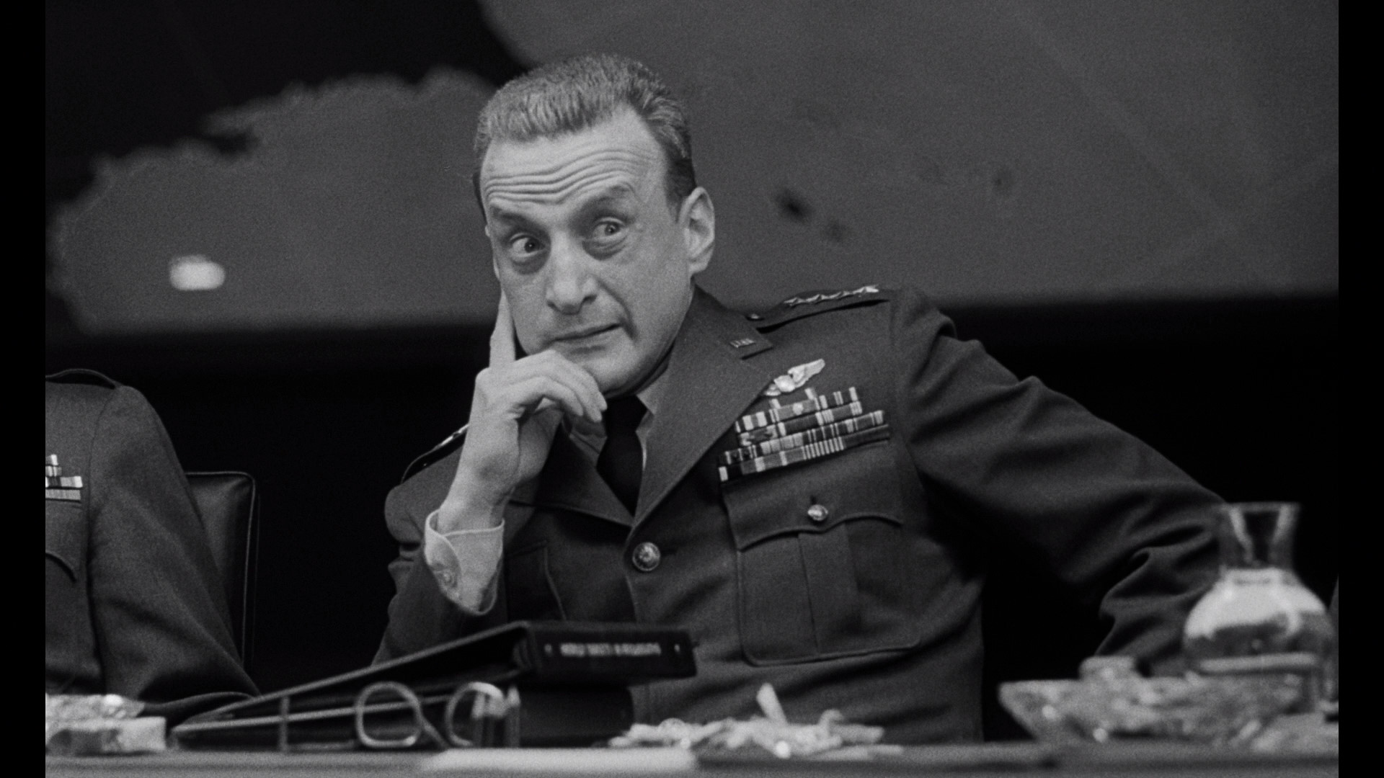
Accelerate
Your
Readiness
by
Using
Visual Basic® Scripting Edition
to
Deploy
SharePoint 2016
in the Enterprise Environment
Ivan Towlson
Microsoft
https://copiouscope.wordpress.com/2013/02/17/dr-strangelove-or-how-i-learned-to-use-a-predictable-title/, the irony of which is not lost on me

Slide 8
functional programmer (noun)
One who names variables x,
names functions f,
and names code patterns zygohistomorphic prepromorphism
@jamesiry

Slide 9
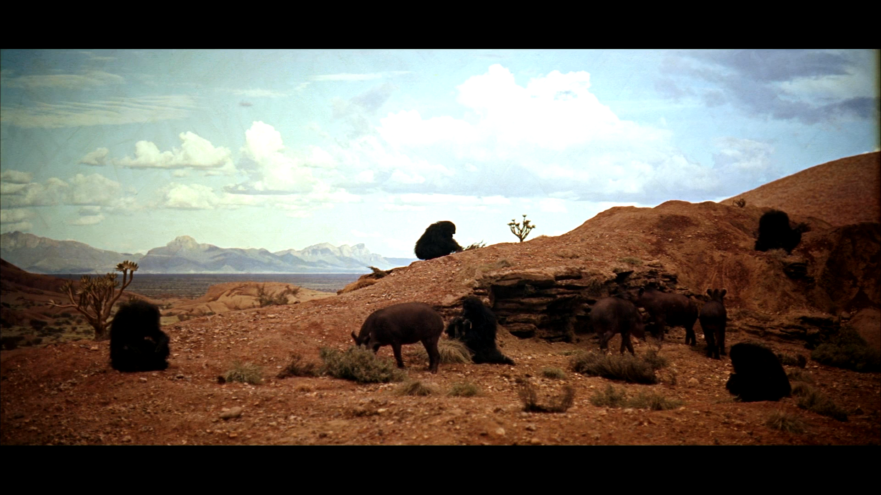
The dawn of history
https://stillsfrmfilms.wordpress.com/2012/07/19/2001-a-space-odyssey/

Slide 10
The dawn of history… 1957
https://stillsfrmfilms.wordpress.com/2012/07/19/2001-a-space-odyssey/

Slide 11
The dawn of history… 1957 1964
10 DIM NEWPRICES(LEN(PRICES))
20 I = 1
30 NEWPRICES(I) = 2 * PRICES(I)
40 I = I + 1
50 IF I <= LEN(PRICES) GOTO 30
60 PRINT "PROFIT!!!"
Disclaimer: Actual history may not have started with BASIC

Slide 12
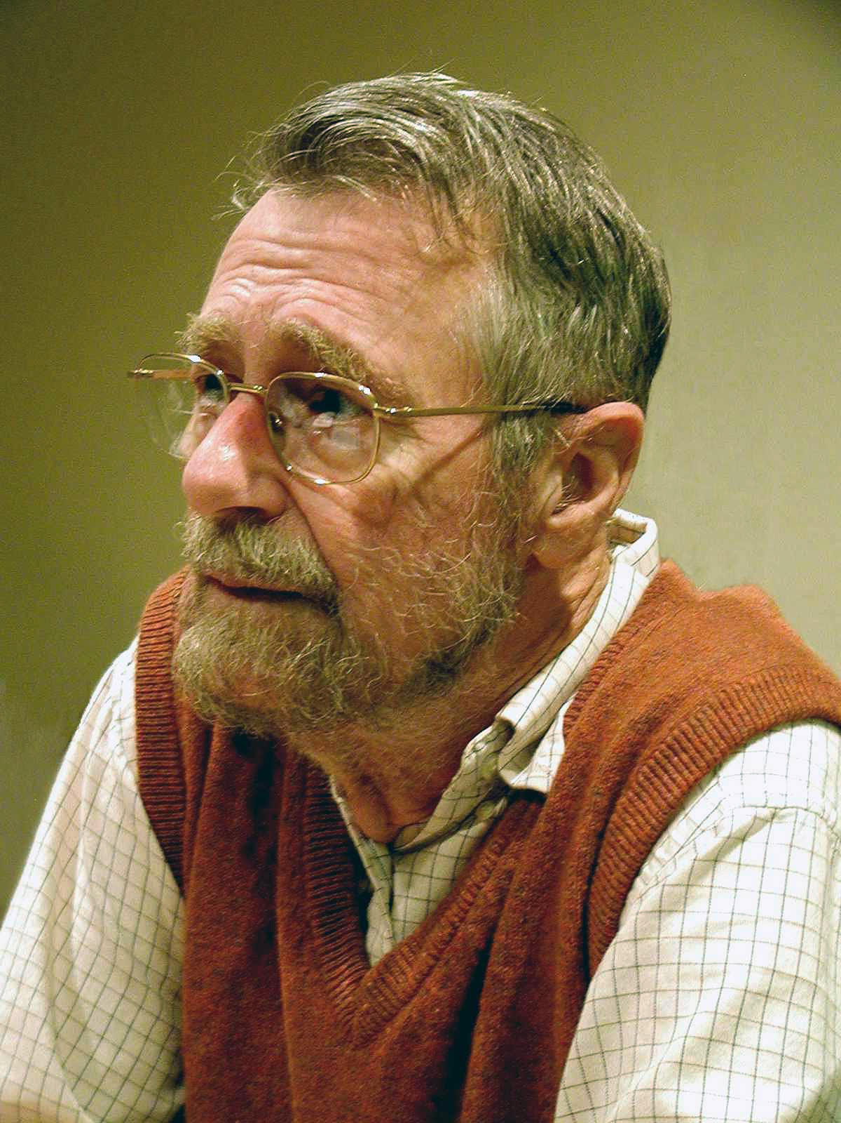
A new hope
By Hamilton Richards - manuscripts of Edsger W. Dijkstra, University Texas at Austin. (Mirrored), CC BY-SA 3.0, https://commons.wikimedia.org/w/index.php?curid=46866934

Slide 13
A new hope
int* newPrices = new int[numPrices];
for (int i = 0; i < numPrices; ++i)
newPrices[i] = 2 * prices[i];

Slide 14
A new hope
List<int> newPrices = new List<int>;
foreach (int price in prices)
newPrices.Add(2 * price);

Slide 15
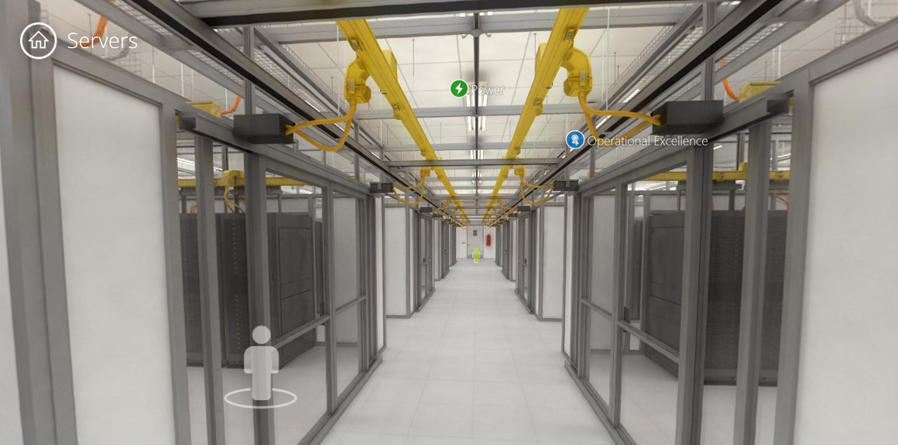
The present day
https://www.microsoft.com/en-us/server-cloud/ms.datacenter.tour/datacenter/servers.html

Slide 16
The present day… 1958
(mapcar (lambda (x) (* x 2)) prices)

Slide 17
The present day
prices.Select(x => x * 2);

Slide 18
The present day
prices |> List.map ((*) 2);

Slide 19
Abstractions
foreach (var p in prices)
newPrices.Add(p * 2);
prices.Select(p => p * 2);

Slide 20
Abstractions
foreach (var c in customers)
if (c.Balance < 0)
deadbeats.Add(c);
customers.Where(c => c.Balance < 0);

Slide 21
Abstractions
foreach (var o in pendingOrders)
outstanding += o.TotalValue;
pendingOrders.Sum(o => o.TotalValue);

Slide 22
Abstractions
foreach (var y in years)
totalInflation *= y.AnnualInflation;
years.Product(y => y.AnnualInflation);

Slide 23
Abstractions
foreach (var s in scores)
best = Max(s, best);
scores.Max();

Slide 24
Abstractions
foreach (var w in words)
endlessBabble += w + " ";
words.CursesSumDoesntWork();

Slide 25
Abstractions… of abstractions
pendingOrders.Sum(o => o.TotalValue);
pendingOrders.Aggregate((acc, o) =>
acc + o.TotalValue);

Slide 26
Abstractions… of abstractions
years.Product(y => y.AnnualInflation);
years.Aggregate((acc, y) =>
acc * y.AnnualInflation);

Slide 27
Abstractions… of abstractions
scores.Max();
scores.Aggregate((acc, s) =>
Max(acc, s));

Slide 28
Abstractions… of abstractions
foreach (var w in words)
endlessBabble += w + " ";
words.Aggregate((acc, w) =>
acc + w + " ");

Slide 29
Sum | Product | Max | Min | …

Slide 30
Aggregate

Slide 31
fold

Slide 32
fold
fold : (accumulator_fn, seed, seq) -> val

Slide 33
seq
seq
map
=>

Slide 34
tree
tree
map
=>

Slide 35
maybe
maybe
map
=>
or
or

Slide 36
(seq, func)
seq
map
(tree, func)
tree
map
(maybe, func)
maybe
map

Slide 37
seq<U> map(seq<T>, func<T,U>)
tree<U> map(tree<T>, func<T,U>)
maybe<U> map(maybe<T>, func<T,U>)

Slide 38
Exploring Functor
string_to<T> : string -> T
length : string_to<int>
vowel_count : string_to<int>
most_frequent : string_to<char>
first_letter : string_to<char>

Slide 39
Exploring Functor
(string_to, func)
string_to
map

Slide 40
Exploring Functor
(string_to, func)
string_to
map
string_to<int>
length
int -> double
sqrt
string_to<double>
length >> sqrt

Slide 41
Exploring Functor
(string_to, func)
string_to
map
string_to<char>
most_frequent
char -> int
ascii
string_to<int>
most_frequent >> ascii

Slide 42
Exploring Functor
(TSrc_to, func)
TSrc_to
map
TSrc_to<string, char>
most_frequent
char -> int
ascii
TSrc_to<string, int>
most_frequent >> ascii

Slide 43
seq<U> map(seq<T>, func<T,U>)
tree<U> map(tree<T>, func<T,U>)
maybe<U> map(maybe<T>, func<T,U>)
func<X,U> map(func<X,T>, func<T,U>)

Slide 44
find out more
Petricek/Skeet, Functional Programming in the Real World
O’Sullivan et al., Real World Haskell
Fogus, Functional JavaScript
fsharpforfunandprofit.com

Slide 45
Thanks!
Ivan Towlson
ivan@hestia.cc | itowlson@microsoft.com
@ppog_penguin | http://hestia.typepad.com

